Slide 1

Data Career Kickstarter
With Microsoft excel & Power bi

Slide 2
Course Outline
a
Module 1 – Introduction to Data Analytics ( 2 hrs )
Module 2 – Excel for Data Analysts ( 8 hrs )
Module 3 – ETL with Power Query ( 4 hrs )
Module 4 – Data Modeling Concepts ( 4 hrs )
Module 5 – Data Analysis in Power BI with DAX ( 8 hrs )
Module 6 – Data visualization and report design ( 4 hrs )
Module 7 – Deploy and maintain Power BI Assets in Power BI Service ( 2 hr )
Module 8 – Introduction to SQL ( 4 hrs )

Slide 3

Module 3 – ETL with Power Query
We will learn
What is ETL?
What is Power Query and when to use it?
Extract (E) – Get data from Excel worksheet, tables and CSV files
Transform (T) – Data cleaning, handling errors, merge and append tables
Load (L) – Query refresh, loading data back into excel or Power BI

Slide 4
Session 1 – What is ETL?

Slide 5
ETL Process: Unlocking Data Insights
The Problem
The Solution
Excel
Transform
CSV
Data is scattered
SAP
Extract
Load
CRM

Slide 6
ETL Process: Unlocking Data Insights
Clean, structure, and enrich data for analysis
Transform
Extract
Load
Retrieve raw data from various sources (databases, files)
Store the transformed data into a final system

Slide 7



How do we do ETL?
Integrated in Microsoft system
Can start with No code/Low code steps, then ease into M language
Free and Opensource
No code/Low code and more visually intuitive for debugging
Most flexible and advanced
Essential for any kind of a database systems

Slide 8
Let’s talk about Power Query!
Scattered and Messy Input
Cleaned, Ready for analysis Output

Slide 9
When to Use Power Query?
Connecting to external data sources
Cleaning messy data
Reshaping data
Automating repetitive preparation tasks

Slide 10
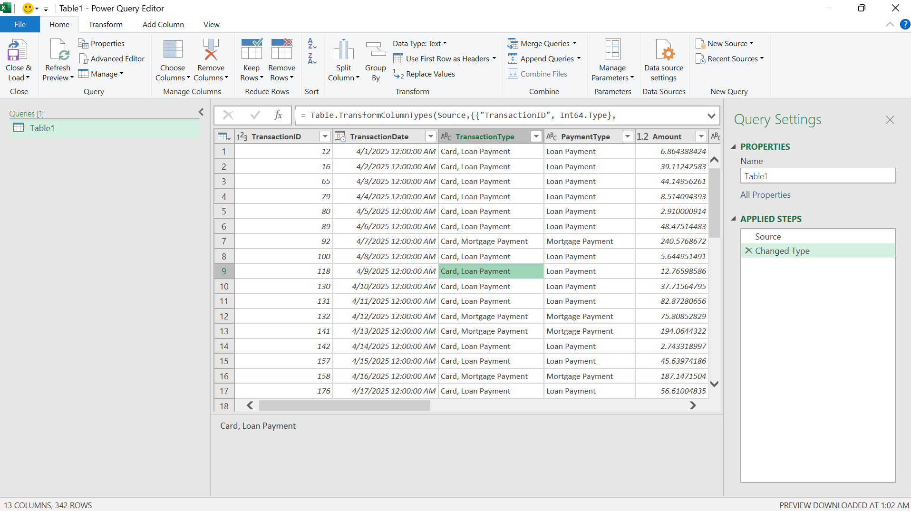
Power Query UI Walkthrough

Slide 11
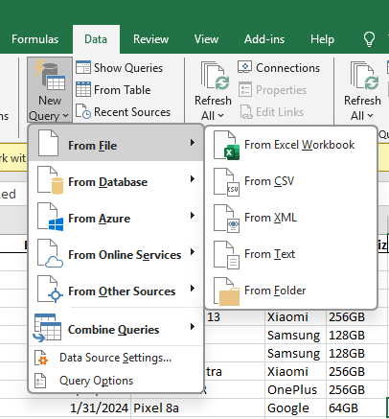
Extract (E) – Getting Data into Power Query
Excel
PowerBI
CSV
Power Query
Table/Range
Database
Excel
Power Query can connect to hundreds of data sources!

Slide 12
Exercise 1 – Extract Data with Power Query
Task 1 – Extract Data from “Module 3 Exercise 1 Extract Data Start” workbook, “Fact_Sales” worksheet and put it into Power Query
Task 2 – Extract Data from “Module 3 Exercise 1 Extract Data Start” workbook, “Dim_Products” table and put it into Power Query as a new source
Task 3 – Extract Data from “Dim_Country.txt” text file and put it into Power Query as a new source

Slide 13
Transform (T) – Preparing data to be analysis ready
Data Quality
Consistency
Analysis ready
Why do we transform?
Power Query’s “Applied Steps” record every action, making it easier to troubleshoot.
Key Benefit: Automation! Once you build a query, you can refresh it to apply the same steps to new data.

Slide 14
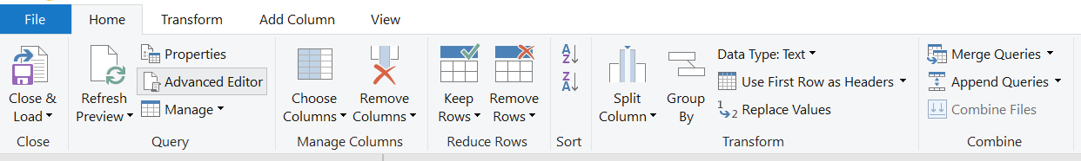
Home Tab
Select only necessary data
Common Transformations
Combining multiple sources

Slide 15
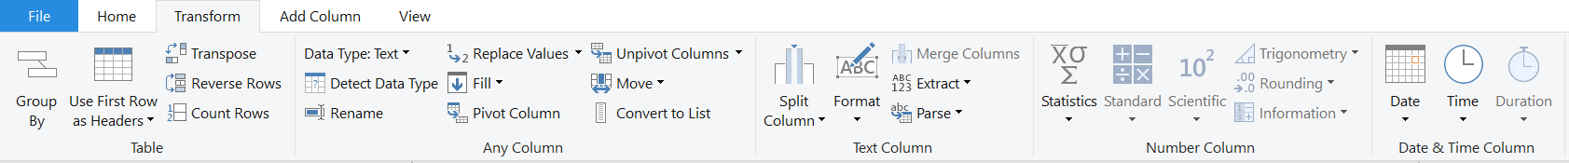
Transform Tab
Manipulates the whole table
Manipulates any column with common transformations
Text only transformations
Number transformations
Date transformations

Slide 16
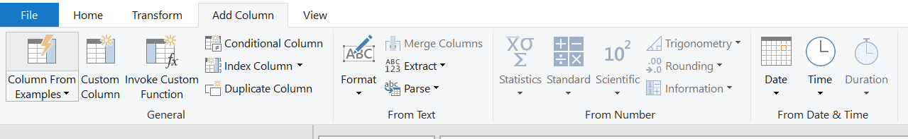
Add Column Tab
Common use cases
New Column from text

Slide 17
Exercise 2 – Transform Data with Power Query
Task 1 – Repeat the steps from exercise 1 using “Module 3 Exercise 2 Transform Data Start (H1)”
Task 2 - Extract Data from “Module 3 Exercise 2 Transform Data Start (H2)” workbook, “Fact_Sales” table and put it into Power Query with the name “Fact_Sales_H2”
Task 3 – Append two queries into a new query “Fact_Sales”
Task 4 – Transform data type of “Transction_Date” column to Date/Time
Task 5 – Add a new column with the brand names extracted from “Mobile_Model” column and rename it as “Brand”

Slide 18
“
“Exceptional results almost exclusively happen when you work hard on an area where you have some natural aptitude. Play to your strengths”
James Clear

